Slide 1
Causal Inference using Machine Learning
Detailed Slides and Notes

Slide 2
Outline
Craft of causal econometrics: Recap
Craft of machine learning: Overview
Causal ML algorithms: Primer
Heterogeneous treatment effect and causal random forests
Policy learning
Hybrid applications

Slide 3
Lecture 1: Craft of Causal Econometrics

Slide 4
Rules of thumb

Slide 5
Instrumental Variables Rules of Thumb

Slide 6
Panel data

Slide 7
Differences in differences rules of thumb

Slide 8
Lecture 2: Machine learning algorithms commonly used by economists

Slide 9
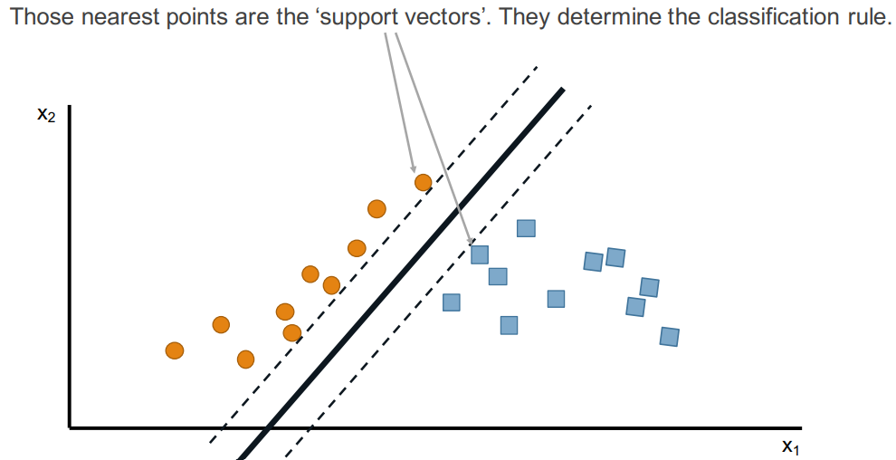
Support Vector Machines (SVM)

Slide 10
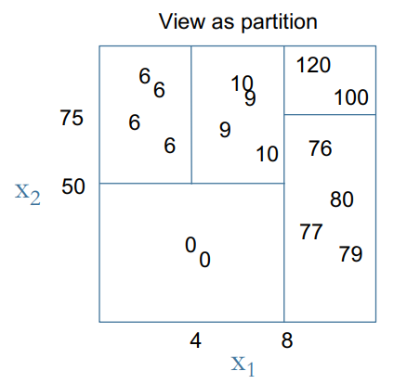
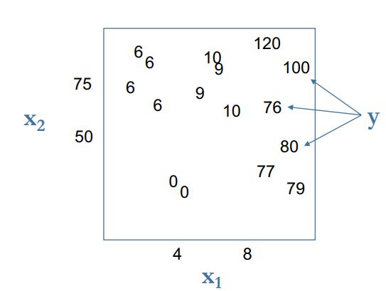
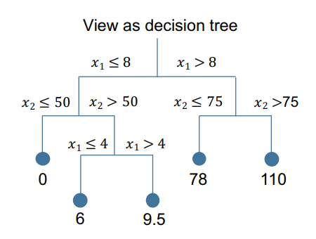
Regression and classification trees
Example: observe $x_{1},x_{2},y$. Build tree to predict $\hat{y}=f(x_{1},x_{2})$

Slide 11
Growing trees: Approach

Slide 12
Bootstrap aggregating (Bagging)

Slide 13
From bagging to random forests

Slide 14
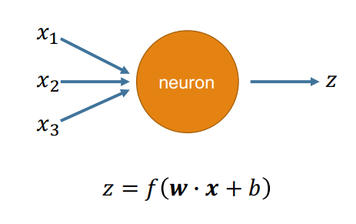
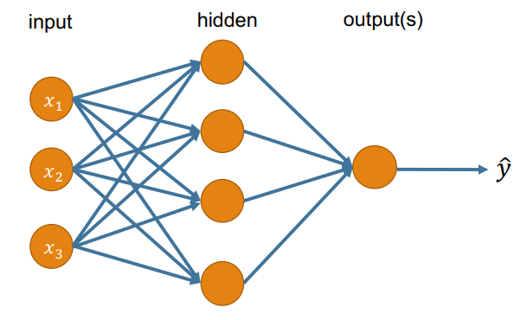
Neural Networks

Slide 15
Convolutional Neural Nets

Slide 16
Cross Validation
A way to
Test your model’s predictive power “out of sample”
Get a sense of uncertainty in your model predictions by generating multiple predictions from multiple models
Choose “tuning” parameters for whatever model you’re using

Slide 17
K-fold, leave one out, repeated K-fold

Slide 18
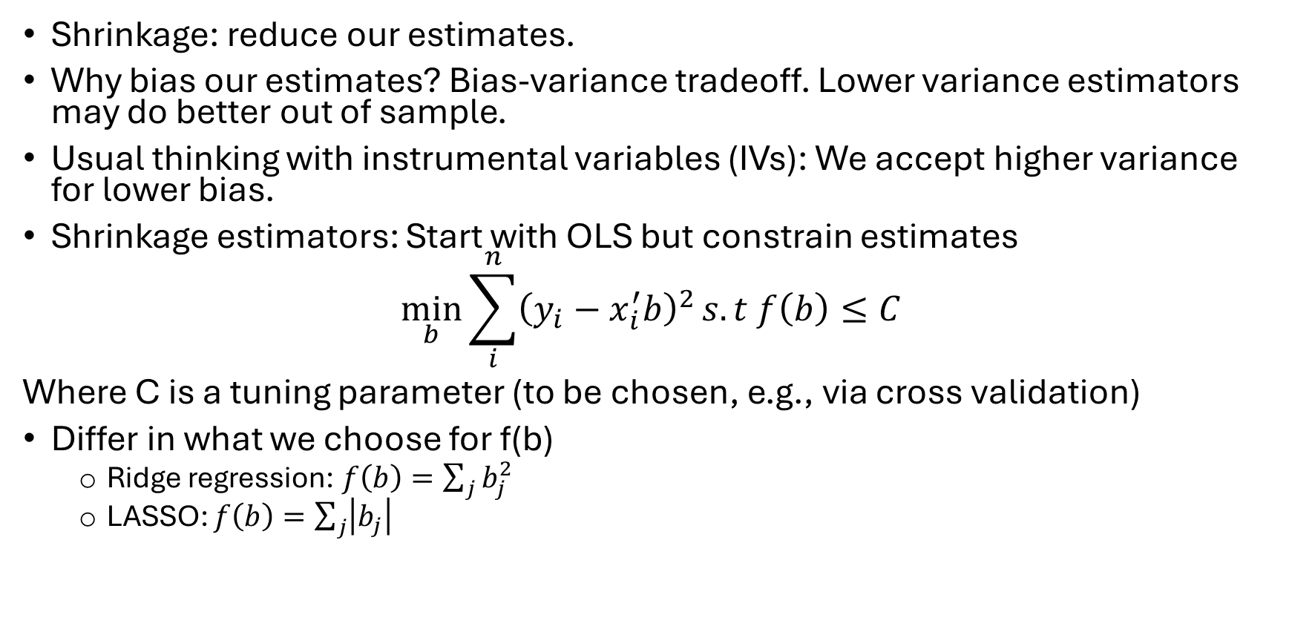
Shrinkage estimators: Ridge, LASSO, post-double LASSO
Shrinkage: reduce our estimates.
Why bias our estimates? Bias-variance tradeoff. Lower variance estimators may do better out of sample.
Usual thinking with instrumental variables (IVs): We accept higher variance for lower bias.
Shrinkage estimators: Start with OLS but constrain estimates
$$\min_{b}{\sum_{i}^{n}{{\left(y_{i}−x_{i}^{′}b\right)}^{2}}s.t f\left(b\right)≤C}$$
Where C is a tuning parameter (to be chosen, e.g., via cross validation)
Differ in what we choose for f(b)
Ridge regression: $f\left(b\right)=\sum_{j}{b_{j}^{2}}$
LASSO: $f\left(b\right)=\sum_{j}{\left|b_{j}\right|}$

Slide 19
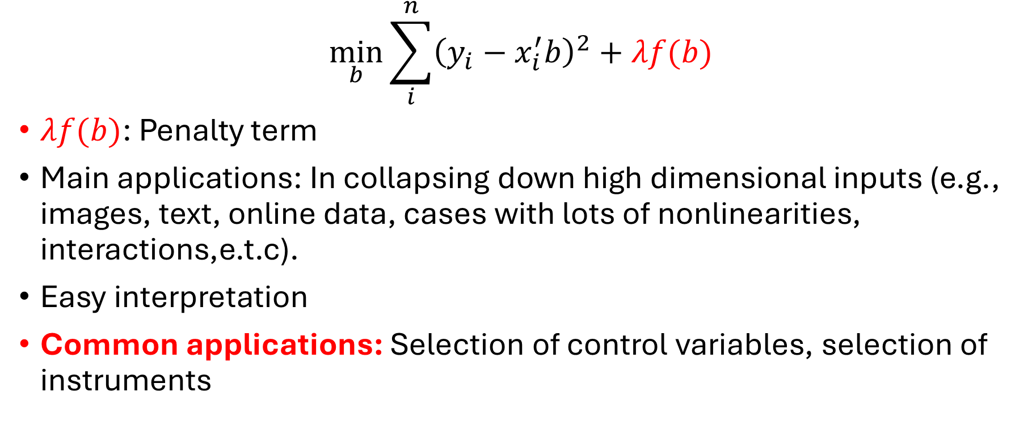
Shrinkage in Lagrangian form
$$\min_{b}{\sum_{i}^{n}{{\left(y_{i}−x_{i}^{′}b\right)}^{2}}+λf(b)}$$
$λf(b)$: Penalty term
Main applications: In collapsing down high dimensional inputs (e.g., images, text, online data, cases with lots of nonlinearities, interactions,e.t.c).
Easy interpretation
Common applications: Selection of control variables, selection of instruments

Slide 20
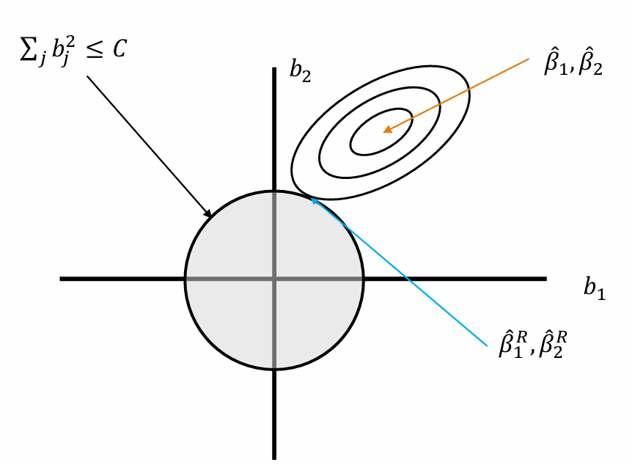
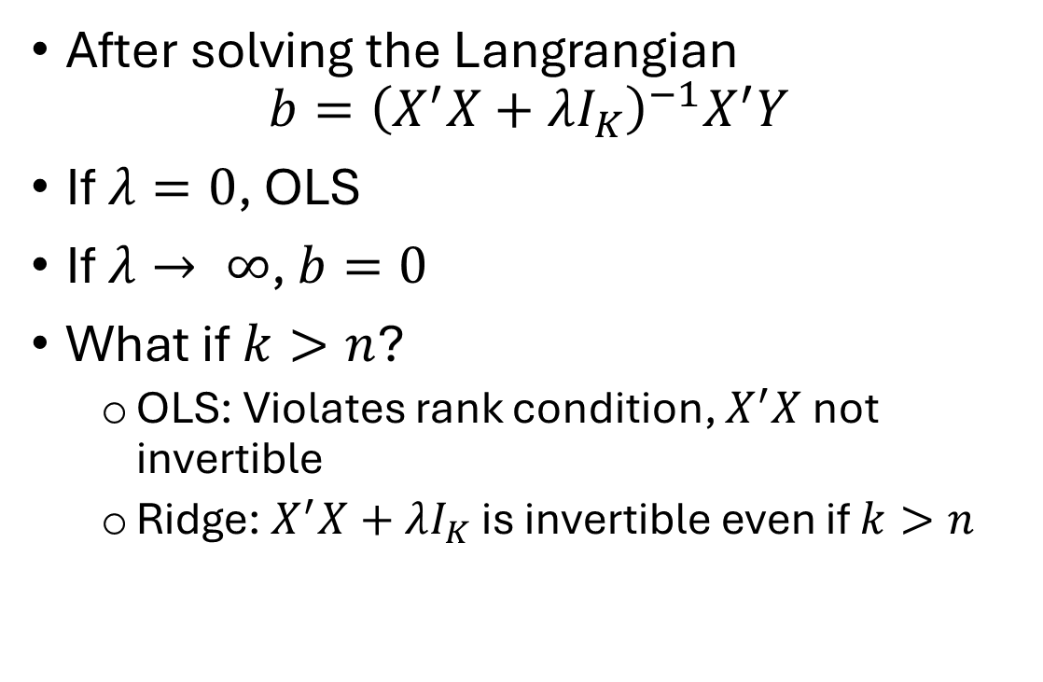
Ridge regression
After solving the Langrangian
$$b={\left(X^{′}X+λI_{K}\right)}^{−1}X^{′}Y$$
If $λ=0$, OLS
If $λ→ ∞$, $b=0$
What if $k>n$?
OLS: Violates rank condition, $X^{′}X$ not invertible
Ridge: $X^{′}X+λI_{K}$ is invertible even if $k>n$

Slide 21
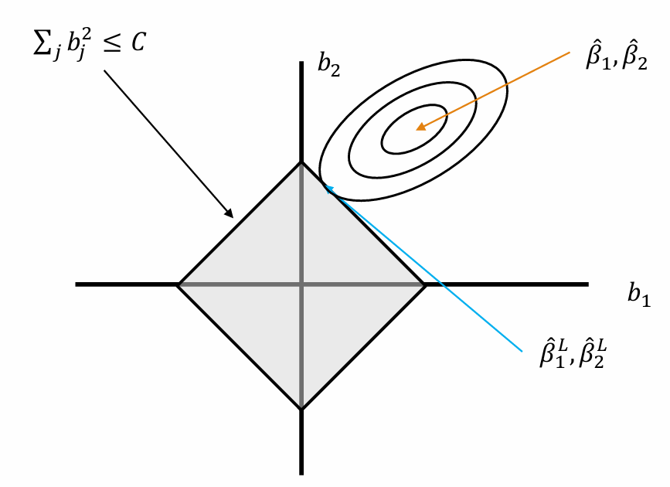
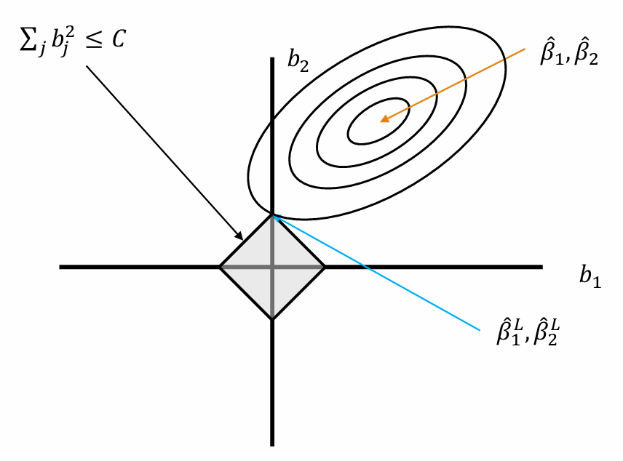
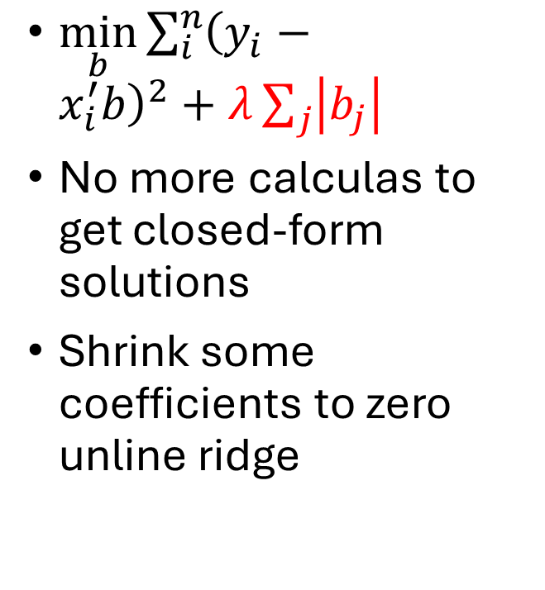
LASSO
$\min_{b}{\sum_{i}^{n}{{\left(y_{i}−x_{i}^{′}b\right)}^{2}}+λ\sum_{j}{\left|b_{j}\right|}}$
No more calculas to get closed-form solutions
Shrink some coefficients to zero unline ridge

Slide 22
LASSO and variable selection
LASSO shrinks some parameters to zero thereby doing automated variable selection
LASSO selects at most n variables but can work with k>n
Application
Narayan et al ####: Doing WEAI with few questions

Slide 23
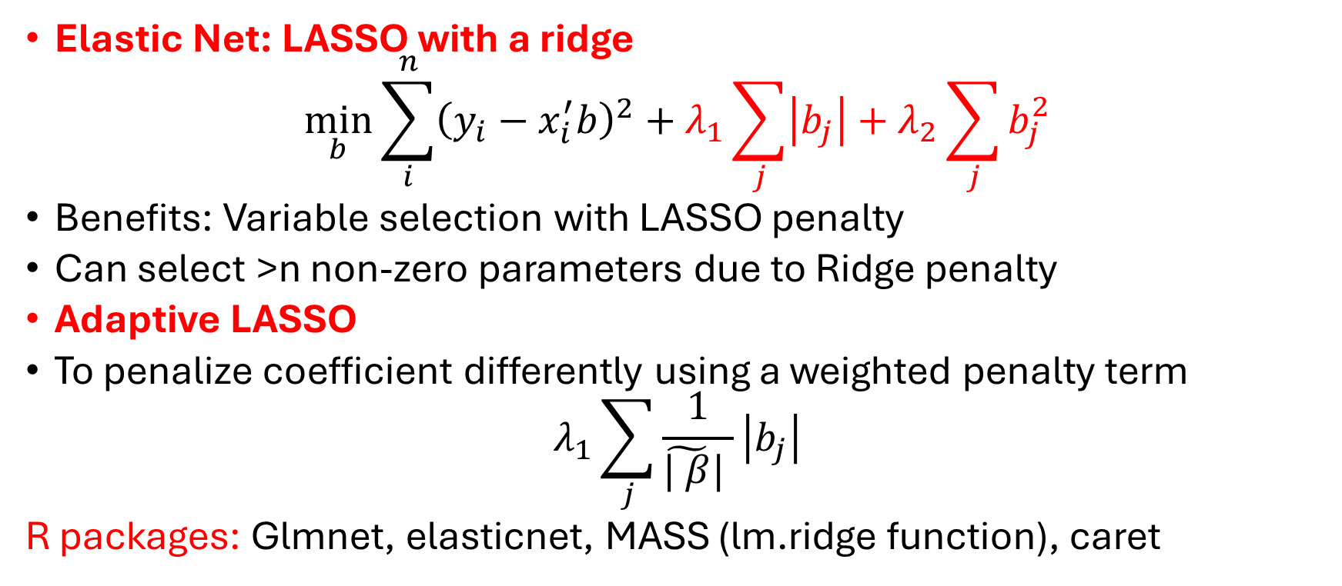
Other shrinkage estimators
Elastic Net: LASSO with a ridge
$$\min_{b}{\sum_{i}^{n}{{\left(y_{i}−x_{i}^{′}b\right)}^{2}}+λ_{1}\sum_{j}{\left|b_{j}\right|}}+λ_{2}\sum_{j}{b_{j}^{2}}$$
Benefits: Variable selection with LASSO penalty
Can select >n non-zero parameters due to Ridge penalty
Adaptive LASSO
To penalize coefficient differently using a weighted penalty term
$$λ_{1}\sum_{j}{\frac{1}{\tilde{| β}| }\left|b_{j}\right|}$$
R packages: Glmnet, elasticnet, MASS (lm.ridge function), caret

Slide 24
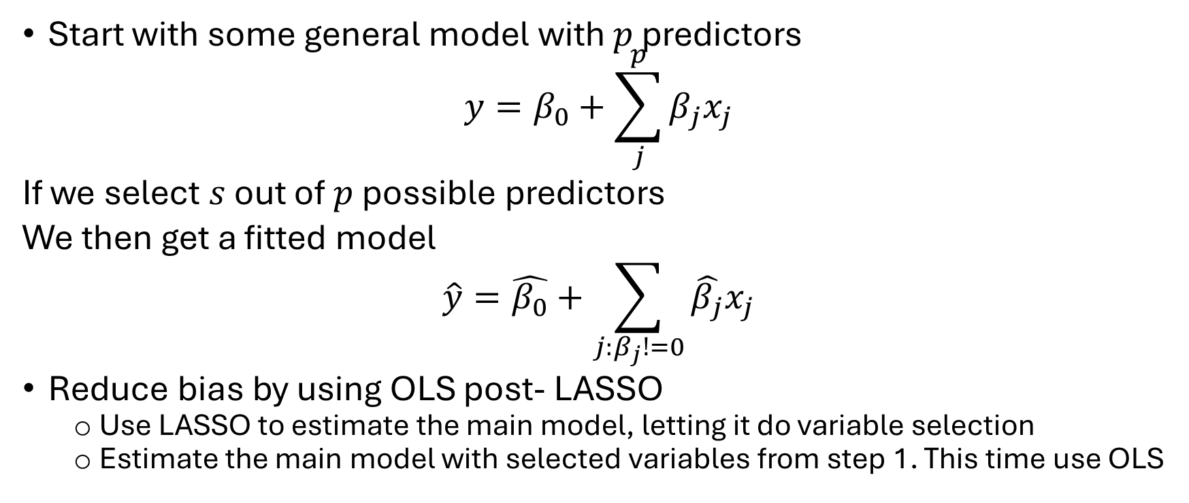
Post-LASSO
Start with some general model with $p$ predictors
$$y=β_{0}+\sum_{j}^{p}{β_{j}x_{j}}$$
If we select $s$ out of $p$ possible predictors
We then get a fitted model
$$\hat{y}=\hat{β_{0}}+\sum_{j:β_{j}!=0}{\hat{β_{j}}x_{j}}$$
Reduce bias by using OLS post- LASSO
Use LASSO to estimate the main model, letting it do variable selection
Estimate the main model with selected variables from step 1. This time use OLS

Slide 25
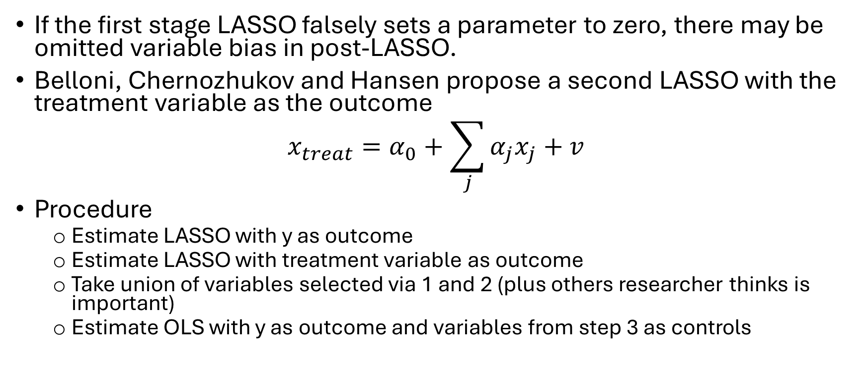
Post-Double LASSO
If the first stage LASSO falsely sets a parameter to zero, there may be omitted variable bias in post-LASSO.
Belloni, Chernozhukov and Hansen propose a second LASSO with the treatment variable as the outcome
$$x_{treat}=α_{0}+\sum_{j}{α_{j}x_{j}}+v$$
Procedure
Estimate LASSO with y as outcome
Estimate LASSO with treatment variable as outcome
Take union of variables selected via 1 and 2 (plus others researcher thinks is important)
Estimate OLS with y as outcome and variables from step 3 as controls

Slide 26
Post Double LASSO Applications
Takeshima and Kishore 2026 Agricultural Systems
Spindler 2016 Journal of Econometrics: LASSO for instrumental variable selection: A replication study

Slide 27
Causal +ML
Aka: Predicting counterfactuals

Slide 28
ML. What is it good for? Prediction
Collapse high-dimensional data down to something useful. Don’t care that much how it happens (if you care there is explainable ML/interpretable ML).
Collapse pixels to single classification
Collapse text down to sentiment or score
Reduce large number of regressors to small and correct number
What if we want to predict a counterfactual? Important for causal inference
We have many ways to this
RCT, regression controls, similar untreated entities via maching, Quasi-exp techniques, simulation via structural models, synthetic controls.

Slide 29
Idea: Use ML to predict counterfactual
With panel data (Carvalho, Masini, Medeiro WP)
Train model of treated unit outcomes as fuct of control unit data in pre-treatment period
Use model 1 and post treatment observable data for control units to predict post treatment counterfactural for treated units
Compare predictions from 2 to actual outcomes to get estimates of treatment effects

Slide 30
ML as a tool for propensity score estimation
Instead of logit, profit or linear probability model in the first stage, one can use ML algorithms for propensity score estimation.
Benefits
Flexibility
Better balance, lower bias
Disadvantage: Algorithm choice, precision

Slide 31
Boosting
Adaptive boosting

Slide 33
Lecture 3: Heterogenous Treatment Effects

Slide 34
Why study heterogenous policy effects?
Policies do no have uniform effects. They vary:
Spatially:
By firm
By individual
Can also vary by duration, time,…
Form of heterogeneity may be useful in targeting future (changes to) policies

Slide 35
But we can study heterogeneity in other ways?
Yes
But
Estimate models on subsamples
Interaction terms in models
Mixed effects or random effects models
Regression trees/Random forests
Which subsamples should we choose?
Which interaction terms do we include?
Is the chosen functional form right? Or parametric assumption right?
Predictive tools are not causal

Slide 36
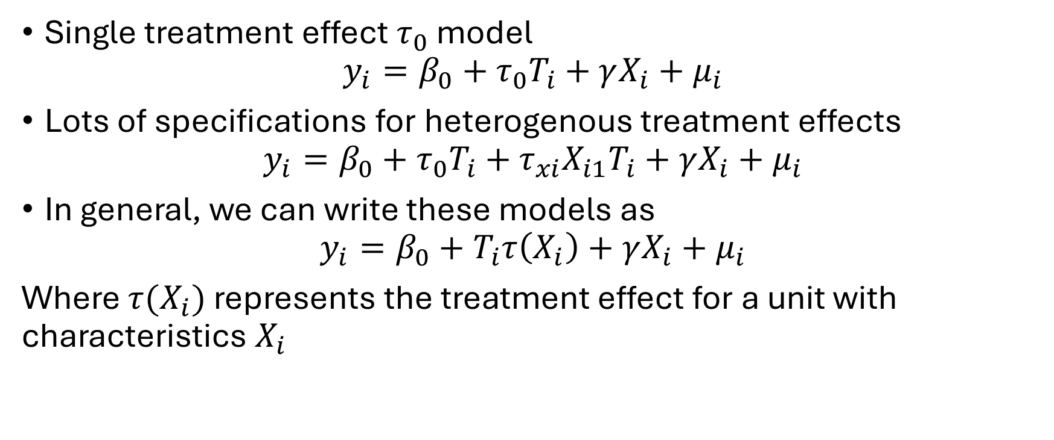
Modeling challenge
Single treatment effect $τ_{0}$ model
$$y_{i}=β_{0}+τ_{0}T_{i}+γX_{i}+μ_{i}$$
Lots of specifications for heterogenous treatment effects
$$y_{i}=β_{0}+τ_{0}T_{i}+τ_{xi}X_{i1}T_{i}+γX_{i}+μ_{i}$$
In general, we can write these models as
$$y_{i}=β_{0}+T_{i}τ\left(X_{i}\right)+γX_{i}+μ_{i}$$
Where $τ(X_{i})$ represents the treatment effect for a unit with characteristics $X_{i}$

Slide 37
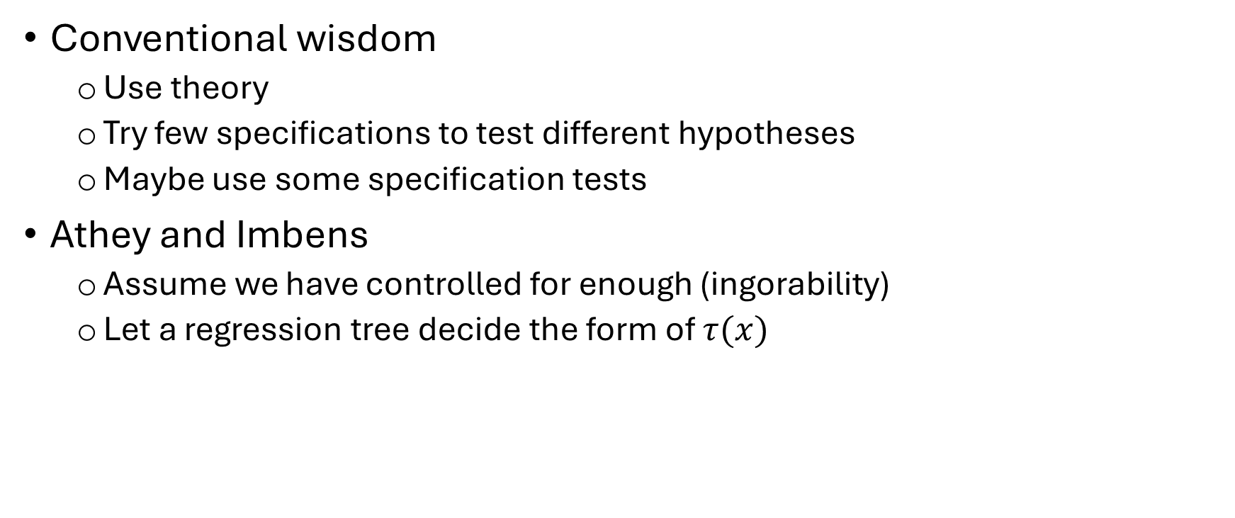
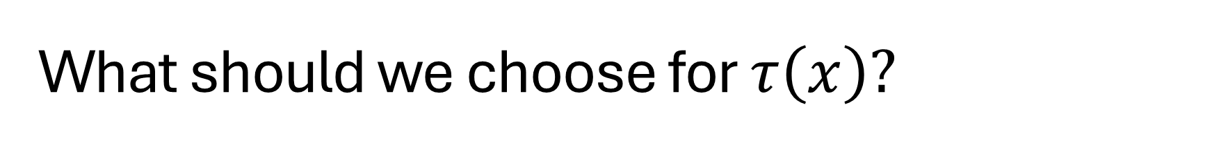
What should we choose for $τ\left(x\right)?$
Conventional wisdom
Use theory
Try few specifications to test different hypotheses
Maybe use some specification tests
Athey and Imbens
Assume we have controlled for enough (ingorability)
Let a regression tree decide the form of $τ(x)$

Slide 38
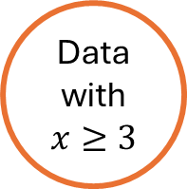

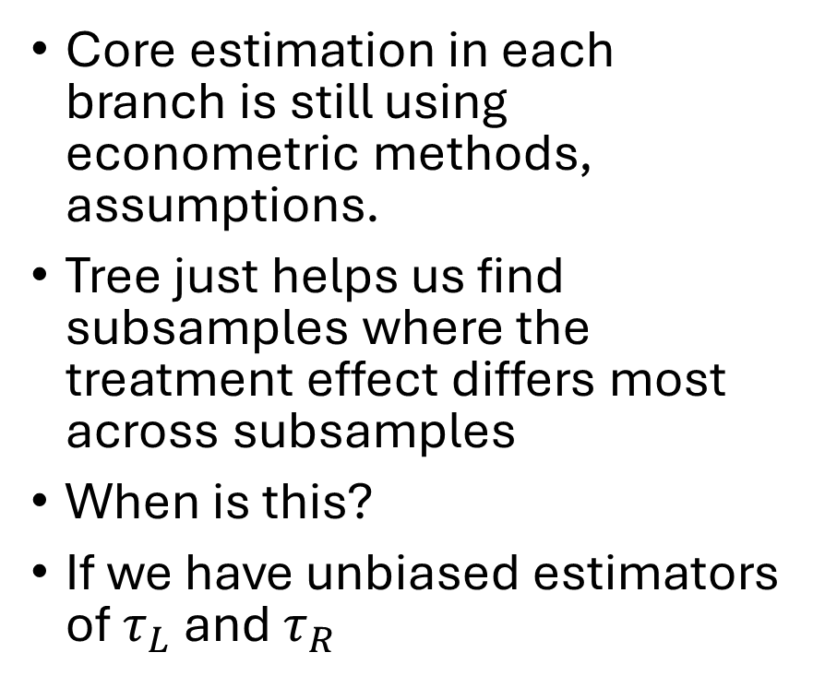



Idea, graphically
All data
Core estimation in each branch is still using econometric methods, assumptions.
Tree just helps us find subsamples where the treatment effect differs most across subsamples
When is this?
If we have unbiased estimators of $τ_{L}$ and $τ_{R}$
$$x<3$$
$$x≥3$$
Data with x<3
Data with $x≥3$
Estimate $τ_{L}$
Estimate $τ_{R}$

Slide 39
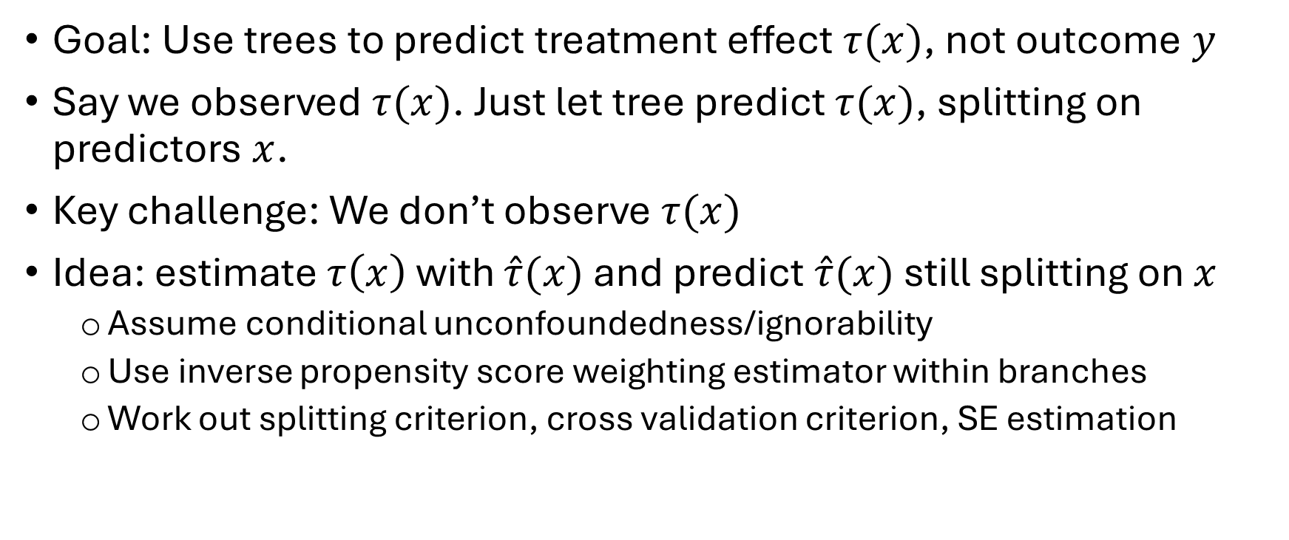
Causal tree method
Goal: Use trees to predict treatment effect $τ(x)$, not outcome $y$
Say we observed $τ(x)$. Just let tree predict $τ(x)$, splitting on predictors $x$.
Key challenge: We don’t observe $τ(x)$
Idea: estimate $τ\left(x\right)$ with $\hat{τ}(x)$ and predict $\hat{τ}(x)$ still splitting on $x$
Assume conditional unconfoundedness/ignorability
Use inverse propensity score weighting estimator within branches
Work out splitting criterion, cross validation criterion, SE estimation

Slide 40
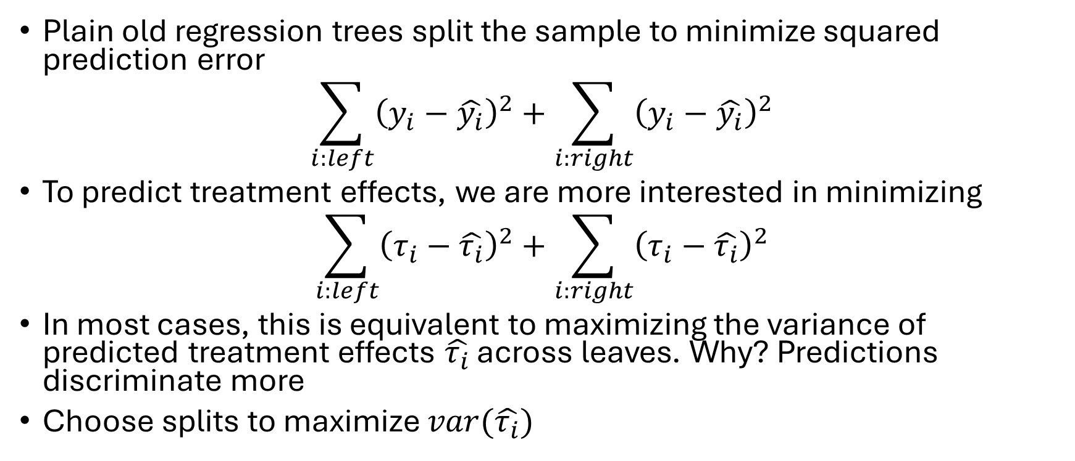
Causal tree intuition
Plain old regression trees split the sample to minimize squared prediction error
$$\sum_{i:left}{{\left(y_{i}−\hat{y_{i}}\right)}^{2}+\sum_{i:right}{{\left(y_{i}−\hat{y_{i}}\right)}^{2}}}$$
To predict treatment effects, we are more interested in minimizing
$$\sum_{i:left}{{\left(τ_{i}−\hat{τ_{i}}\right)}^{2}+\sum_{i:right}{{\left(τ_{i}−\hat{τ_{i}}\right)}^{2}}}$$
In most cases, this is equivalent to maximizing the variance of predicted treatment effects $\hat{τ_{i}}$ across leaves. Why? Predictions discriminate more
Choose splits to maximize $var(\hat{τ_{i}})$

Slide 42
Lecture 4: Agricultural policy analysis applications

